Slide 1



Microsoft Stock Analysis
Last data refresh:
12/8/2022 6:03:24 PM UTC
Downloaded at:
12/8/2022 6:07:17 PM UTC

Slide 2
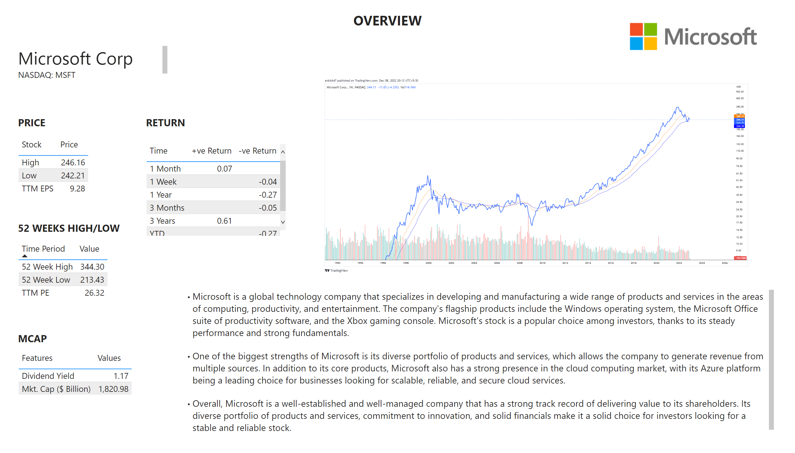
Overview
Notes:
tableEx
No alt text provided
textbox
No alt text provided
textbox
No alt text provided
image
No alt text provided
textbox
No alt text provided
image
No alt text provided
textbox
No alt text provided
tableEx
No alt text provided
tableEx
No alt text provided
tableEx
No alt text provided
textbox
No alt text provided
textbox
No alt text provided
textbox
No alt text provided

Slide 3
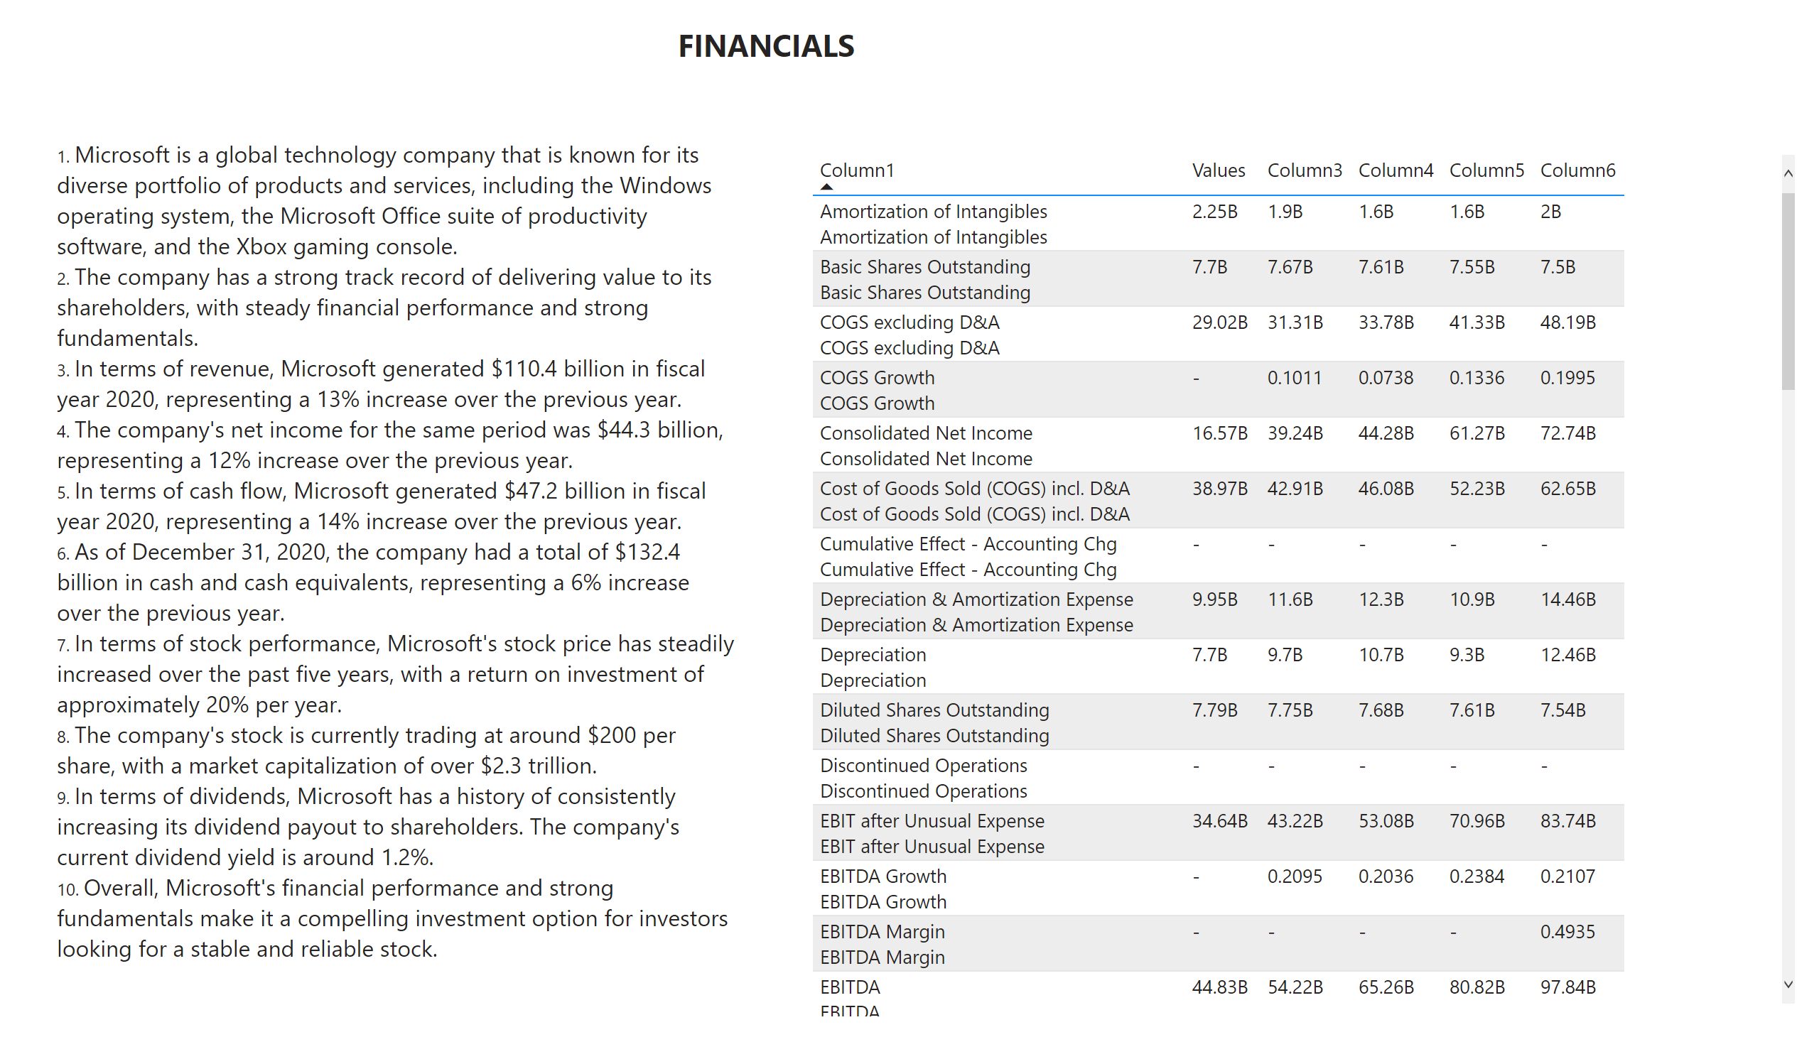
FINANCIALS
Notes:
tableEx
No alt text provided
textbox
No alt text provided
textbox
No alt text provided

Slide 4
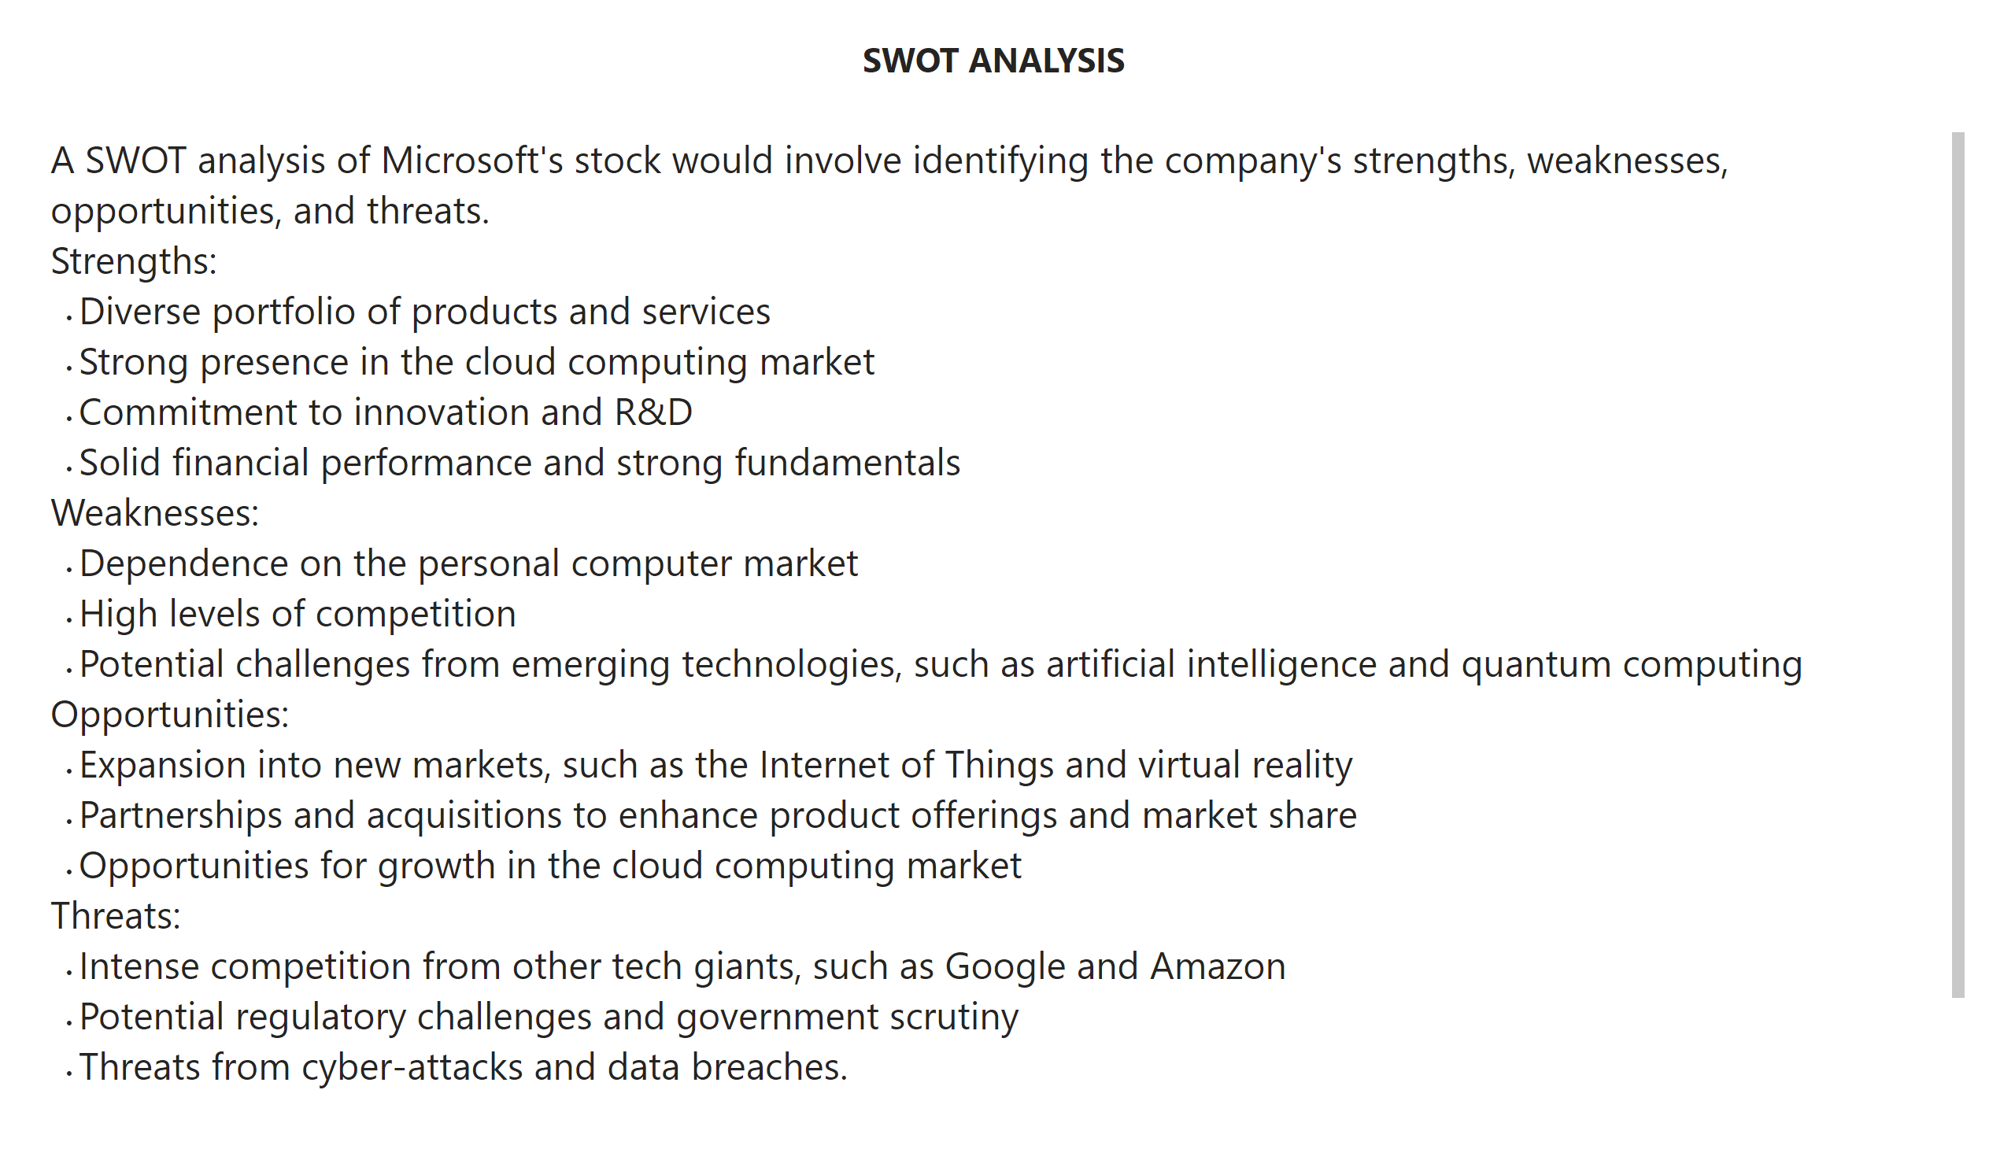
SWOT Analysis
Notes:
textbox
No alt text provided
textbox
No alt text provided

Slide 5
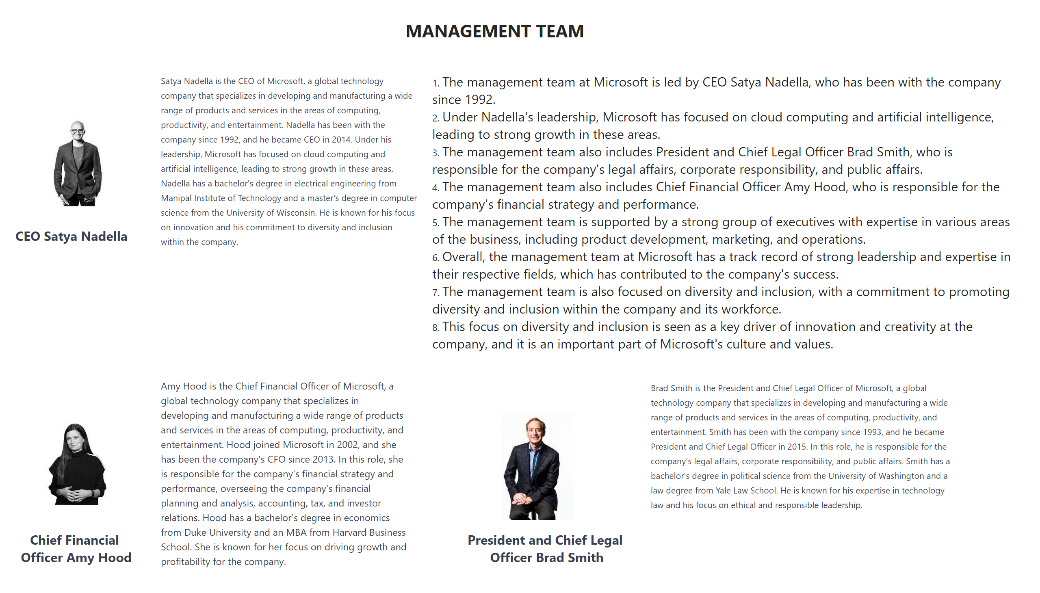
Management Team
Notes:
textbox
No alt text provided
textbox
No alt text provided
image
No alt text provided
image
No alt text provided
image
No alt text provided
textbox
No alt text provided
textbox
No alt text provided
textbox
No alt text provided
textbox
No alt text provided
textbox
No alt text provided
textbox
No alt text provided

Slide 6
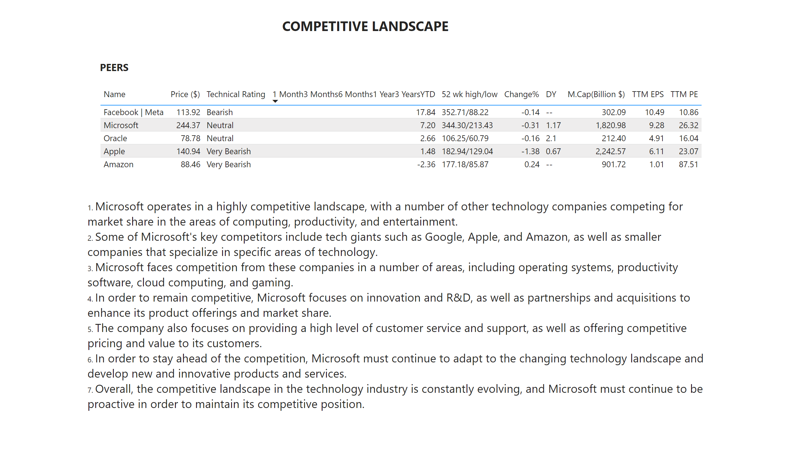
Competitive Landscape
Notes:
textbox
No alt text provided
textbox
No alt text provided
tableEx
No alt text provided
textbox
No alt text provided

Slide 7
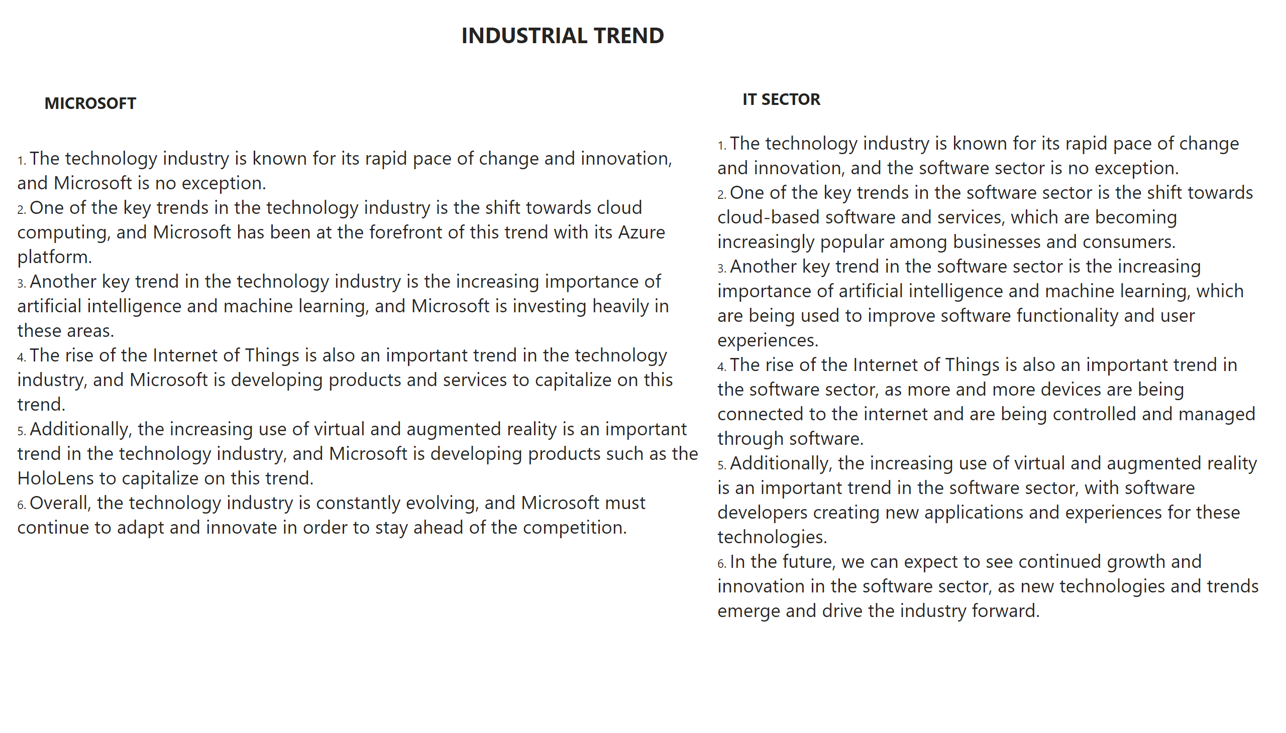
Industrial Trend
Notes:
textbox
No alt text provided
textbox
No alt text provided
textbox
No alt text provided
textbox
No alt text provided
textbox
No alt text provided

Slide 8
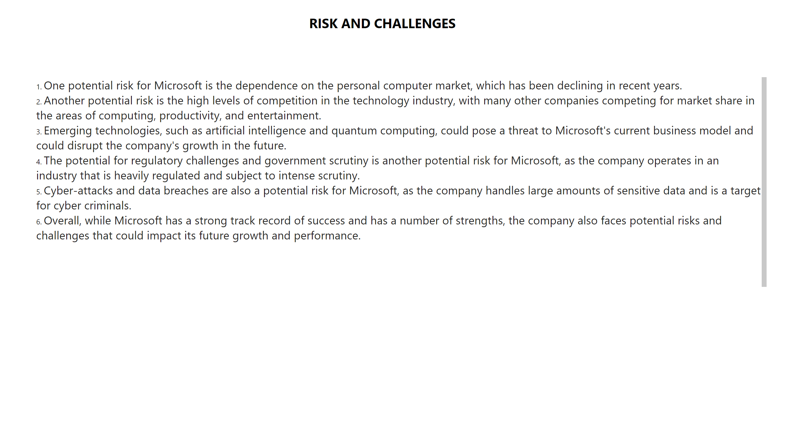
Risk And Challenges
Notes:
textbox
No alt text provided
textbox
No alt text provided

